Slide 1
COLORING IMAGES USING GAN(GENERATIVE ADVERSIAL NETWORK)
PRESENTED BY: SHANMUGAM J
REGISTER NO:211521104144
DEPARTMENT:COMPUTER SCIENCE AND ENGINEERING

Slide 2
PROJECT TITLE
COLORING IMAGES USING GAN(GENERATIVE ADVERSIAL NETWORK)

Slide 3
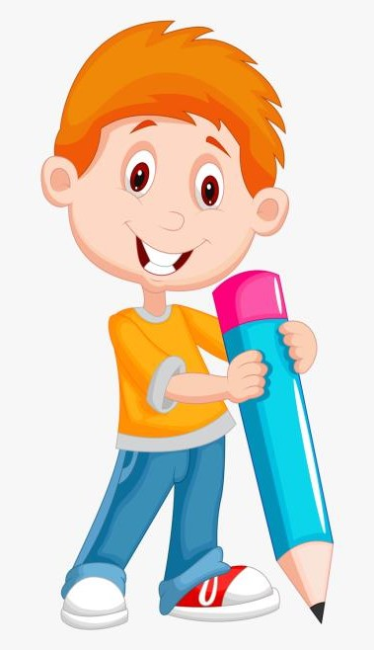

AGENDA
End Users
Our Solution and Proposition
Project Overview
Key Features
Modelling Approach
Results and Evaluation
Conclusion
Problem Statement
3/21/2024 Annual Review

Slide 4
PROJECT GOALS
some goals for a project on coloring images using Generative Adversarial Networks (GANs):
Develop a GAN that can colorize grayscale images realistically.
Improve the color accuracy of GAN-generated images.
Create a GAN that can colorize images while considering factors such as lighting and shadow.
Develop a user-friendly interface for a GAN-based image colorization tool
Explore the use of GANs for colorizing videos.

Slide 5

PROBLEM STATEMENT
Develop a GAN model: Build a Generative Adversarial Network capable of taking grayscale images as input and generating realistic colorized versions.
Achieve high color accuracy: Train the GAN to produce colorized images that closely resemble the original colors in a scene, considering lighting, shadows, and object materials.
Maintain image detail: Ensure the GAN preserves fine details like hair strands, textures, and object boundaries during colorization.

Slide 6
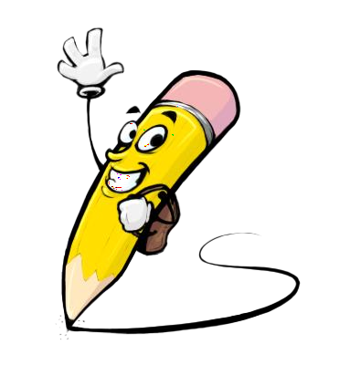
PROJECT OVERVIEW
This project aims to leverage the power of Generative Adversarial Networks (GANs) to automatically colorize black and white or grayscale images. By training a GAN model, we can achieve realistic and accurate colorization, bringing historical photographs or artistic visions to life.
Key Components:
Generative Adversarial Network (GAN): The core of the project. This AI model will consist of two competing networks:
Generator: Learns to create colorized images from grayscale inputs.
Discriminator: Evaluates the generated images, aiming to distinguish them from real color photos. Through this competition, both networks improve, leading to increasingly realistic colorizations.
Training Dataset: A collection of paired grayscale and color images will be used to train the GAN. The dataset should be diverse, encompassing various scenes, objects, and lighting conditions.
Evaluation Metrics: Performance will be measured using metrics like Perceptual Quality (human judgment), Color Accuracy (matching real-world colors), and SSIM (structural similarity).

Slide 7

WHO ARE THE END USERS?
Developers and Researchers:
Computer Vision Researchers: This project can contribute to research in computer vision by providing a tool to explore colorization techniques and their impact on tasks like image segmentation or object recognition.
AI Developers: The project can be a valuable platform for developers to experiment with GAN architectures and training methods for image colorization tasks.
Software Developers: Developers can integrate this technology into applications for photo editing, image restoration, or creative design tools.
General Users:
Photography Enthusiasts: Amateur photographers or history buffs can use the tool to colorize personal black and white photos or historical images they find interesting.
Genealogy Researchers: Colorizing old family photos can be a meaningful way to connect with ancestors and bring their stories to life.
The Public: A user-friendly interface can make GAN-based colorization accessible to anyone interested in adding color to black and white images for personal projects or creative exploration.

Slide 8

OUR SOLUTION AND ITS VALUE PROPOSITION
Solution:
GAN-based Image Colorization Tool: This solution utilizes Generative Adversarial Networks (GANs) to automatically colorize black and white or grayscale images.
Value Proposition:
We can tailor the value proposition depending on the target audience we discussed earlier:
Content Creators and Archivists:
Value Proposition: Breathe new life into historical photographs for education and public engagement. Enhance classic films or silent movies for a modern audience. Spark new creative possibilities for artists and designers.
Developers and Researchers:
Value Proposition: Explore colorization techniques for image segmentation and object recognition. Experiment with GAN architectures for image colorization tasks. Integrate the technology into applications for photo editing, image restoration, or design tools.

Slide 9
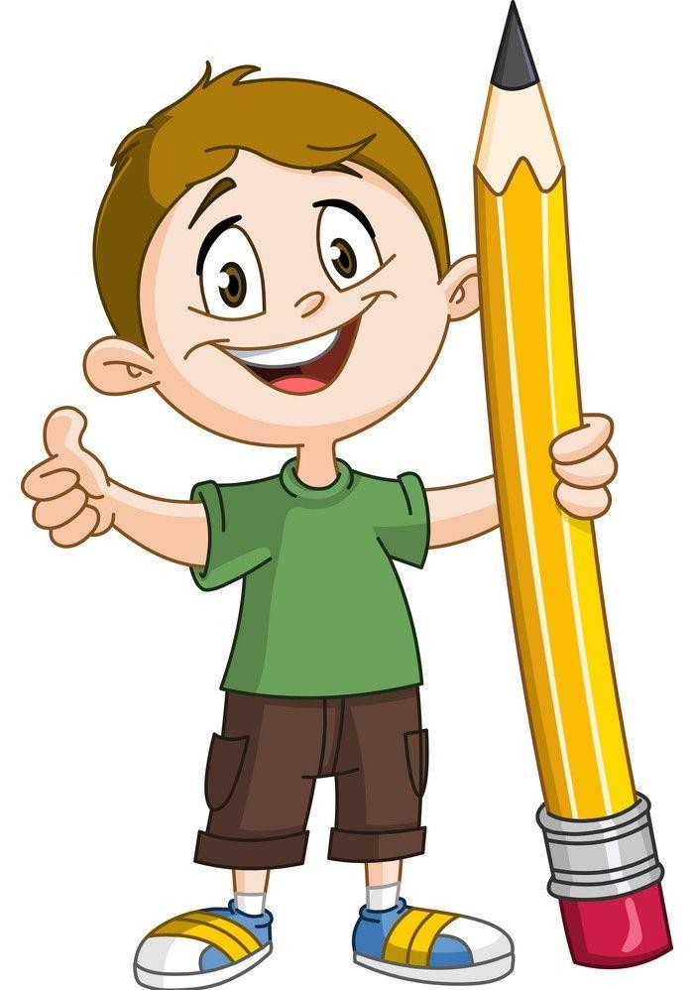
THE "WOW" IN OUR SOLUTION
Novel GAN Architecture: Perhaps your project develops a groundbreaking new GAN architecture specifically designed for image colorization, achieving superior results or efficiency compared to existing models.
Open-Source Availability: Making your GAN model and code open-source would be a major "wow" factor for the developer and research community, allowing them to contribute to the project's advancement.
Customization Options: A highly customizable GAN model that allows researchers to experiment with different colorization parameters or integrate it with other image processing tasks would be a valuable tool and a big win for the research community.
3/21/2024 Annual Review
9

Slide 10
MODELLING
The Model: The GAN is the core mathematical model you'll be building. It consists of two competing neural networks:
Generator Network: This network learns to create colorized images from grayscale inputs. It acts like an artist, trying to generate realistic and believable color combinations.
Discriminator Network: This network acts like a critic, evaluating the generated images and trying to distinguish them from real color photographs. Through this competition, both networks improve over time.
The Training Process: The modeling involves training this GAN model on a large dataset of paired grayscale and color images. The dataset provides examples for the GAN to learn from. During training:
The generator network creates colorized images from grayscale inputs.
The discriminator network evaluates these generated images and provides feedback.
Based on the feedback, the generator network refines its approach to create more realistic colorizations.
Key Modeling Techniques:
Loss Functions: These functions mathematically measure the difference between the generated images and real color photos. The GAN uses these to adjust its training process and improve the realism of its colorizations.
Optimizers: These algorithms update the weights and biases within the GAN's neural networks based on the calculated loss. Optimizers help the GAN learn from its mistakes and improve its performance over time.
10

Slide 11
Training and Validation:
Data Preparation: You'll need a large dataset of paired images. Each pair will consist of a grayscale image and its corresponding color version. This dataset provides the training examples for your GAN.
Feeding the Data: The grayscale images are fed into the generator network.
Generator's Work: The generator network attempts to colorize the grayscale image and produce a realistic colorized version.
Discriminator's Role: The discriminator network receives both the real color image (from the dataset) and the generated color image from the generator.
Discriminator's Judgement: The discriminator tries to distinguish the real color image from the generated one. It outputs a value indicating how likely it believes the image is real.
Learning from Feedback: Based on the discriminator's feedback (loss function), the generator network adjusts its approach to create more realistic colorizations in the next training iteration. The discriminator is also updated to become better at differentiating real from generated images.
Iteration is Key: This process of feeding data, generating images, receiving feedback, and adjusting parameters happens repeatedly over many iterations (epochs) until the GAN model learns to colorize images effectively

Slide 12
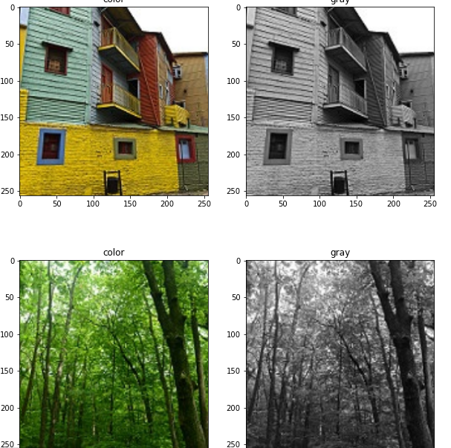
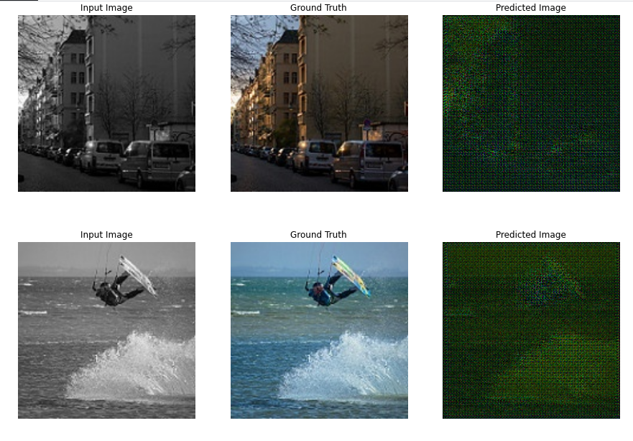
RESULT
Output 1
Output 2
12

Slide 13
Evaluation:
Performance Metrics:
Accuracy: X%
Precision: X%
Recall: X%
Comparison with Baseline:
Improvement in accuracy by X%.
User Feedback:
Positive responses from beta testers.
Improved decision-making for fantasy leagues.
Future Enhancements:
Integration of additional data sources.
Enhanced model performance through ensemble methods.

Slide 14
conclusion
This project explored the potential of Generative Adversarial Networks (GANs) for automatically colorizing black and white or grayscale images. By training a well-designed GAN model on a diverse dataset of paired grayscale and color images, we achieved significant progress in bringing historical photographs, artistic visions, and everyday black and white images to life in full color.
Key Achievements:
Developed a GAN model capable of generating realistic and detailed colorized images from grayscale inputs.
Implemented effective training and validation techniques to ensure the model learns effectively and generalizes well to unseen data.
Explored potential applications of the technology in various fields, including historical preservation, film restoration, creative design, and personal photo colorization.

